Slide 1
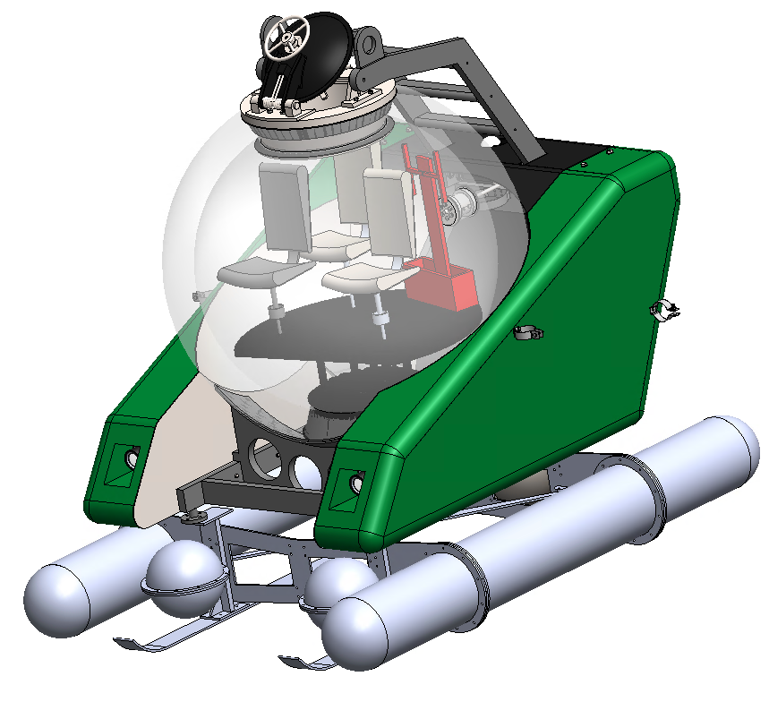
Kraken
Jonas Chianu (8090727)
Otito Situ (8315067)
Munachiso Izuora (8069751)
(Jason) Siyuan Ji (7696601)
Kenneth Oguejiofor (8327214)
SUB-1A

Slide 2
Presentation Outline
Project Requirements
Solution
Parameterization

Slide 3
Requirements
Submersible must attain speeds from 2 to 6 knots (~4km/hr-11km/hr).
Diving depth between 330m and 1000m.
Submarine should be properly sealed and be corrosion resistant.

Slide 4
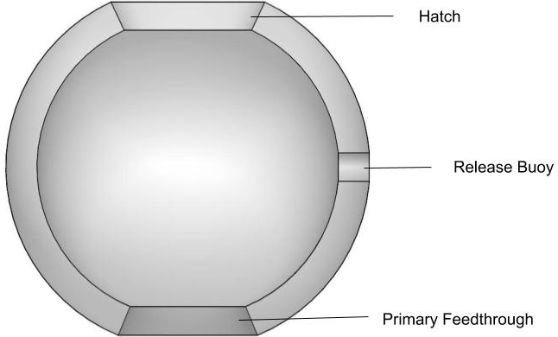
Acrylic Pressure Hull
Notes:
Hull

Slide 5
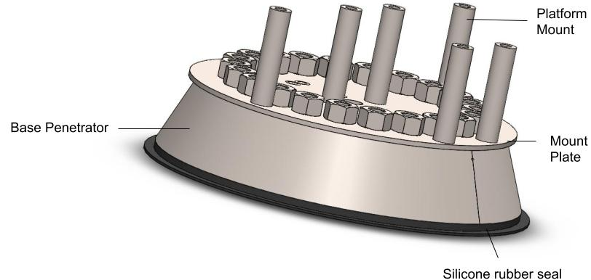
Primary Feedthrough

Slide 6
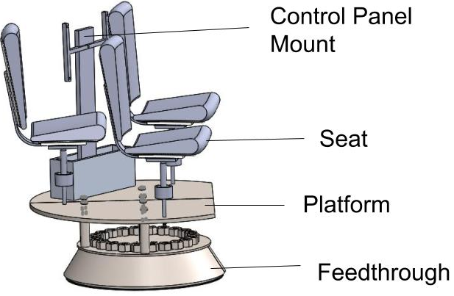
Seating Assembly

Slide 7
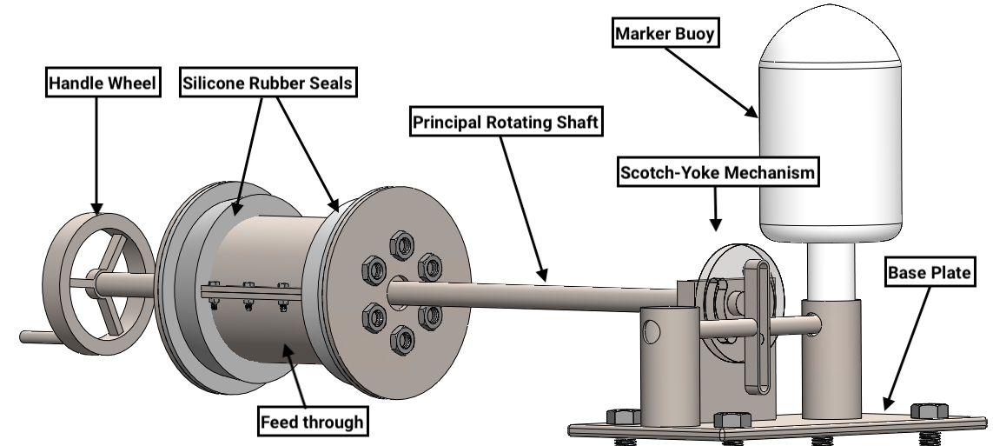
Release Buoy

Slide 8
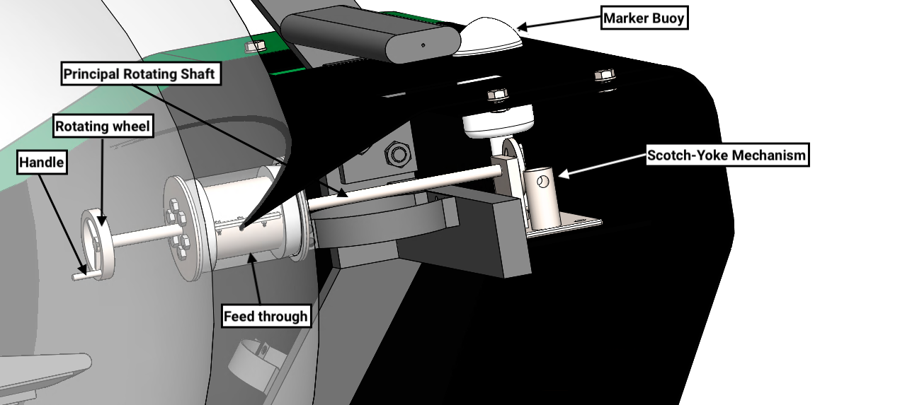
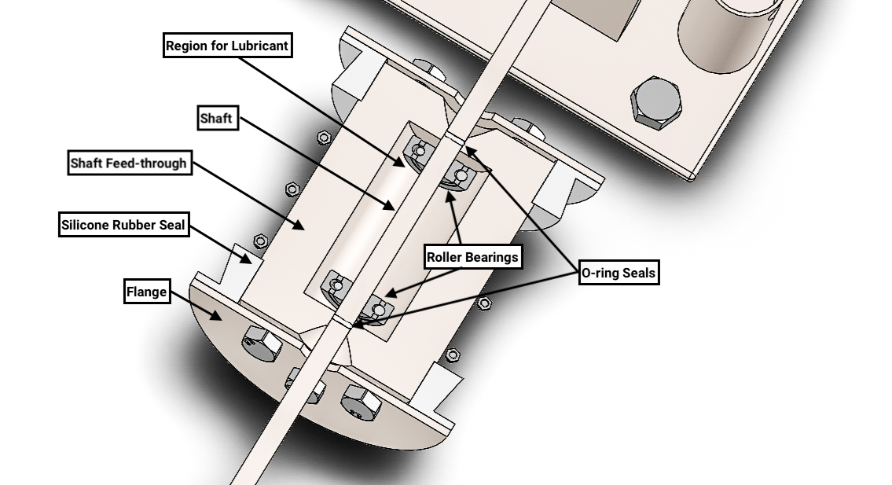
Release Buoy
Release Buoy Mounting
Feedthrough Cross-section

Slide 9
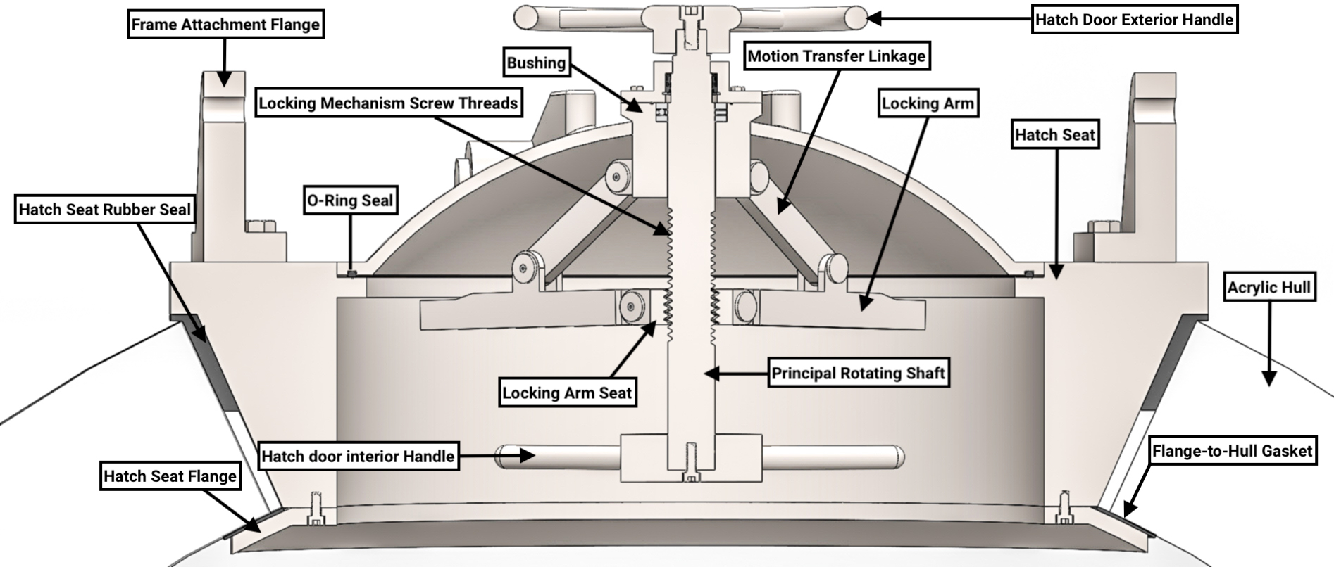
Hatch

Slide 10
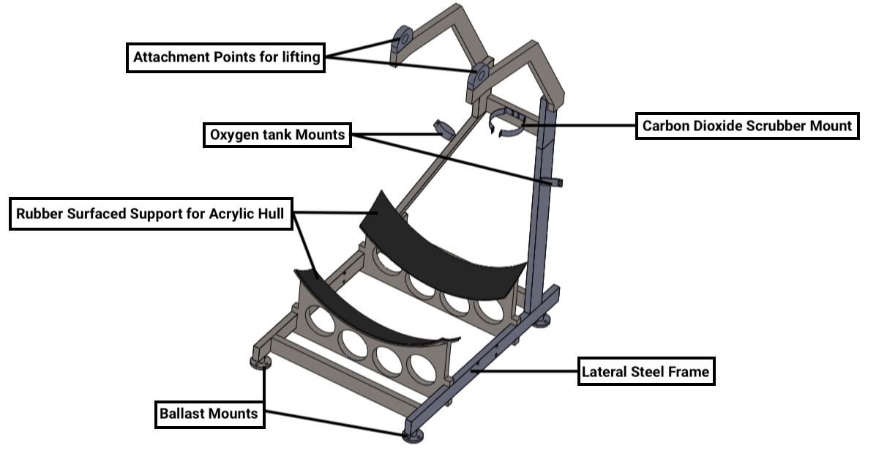
Frame
Frame
Two major functions: framework and Support
Strength and size
Provides surface for mounts and lifting attachment
Bottom Frame design
Ballast Interconnectivity
Notes:
Overall System
Space for compressed air
As a mount for CO₂ scrubber and O₂ tanks

Slide 11
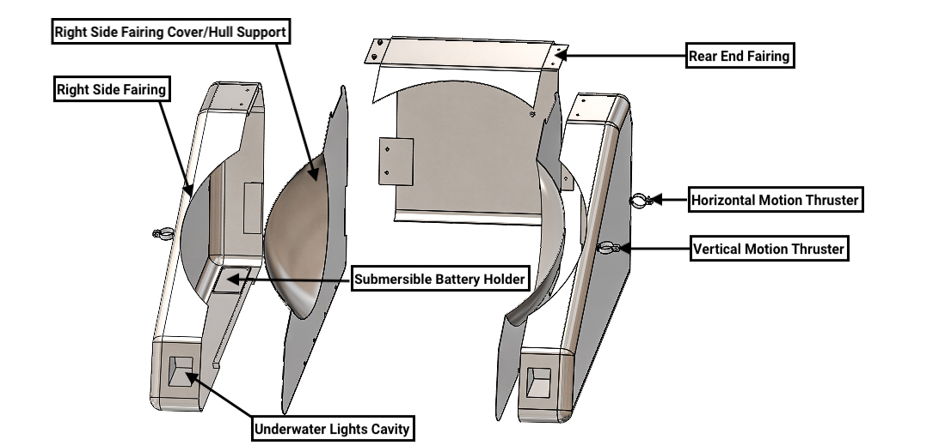
Fairings
Houses the major components for the submarine
Comprised of 3 different parts
Provides Buoyancy
Attachment points, mounting point, light compartment
Size and Speed
Notes:
Fairing

Slide 12
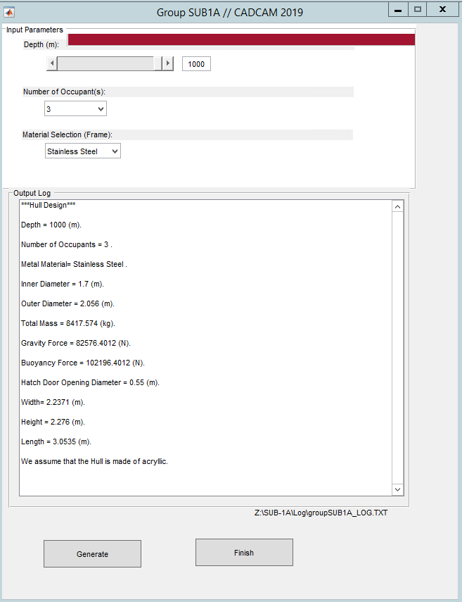
Parameterization
The consumer can customize the following input parameters:
Submarine dive depth
Number of Occupants
Material Selection
Notes:
All components talked about so far are parameterizable.
However, components such as the fairings, release buoy, penetrator and seat platform change relative to other major components
For example, the main penetrator at the bottom of the acrylic hull will change dimensions relative to the thickness of the hull. The release buoy will also change relative to the space provided for it in the rear fairing.
We built our parameterization outline around 3 input parameters namely: the required dive depth, number of occupants and material selection for components such as the frame and fairings

Slide 13
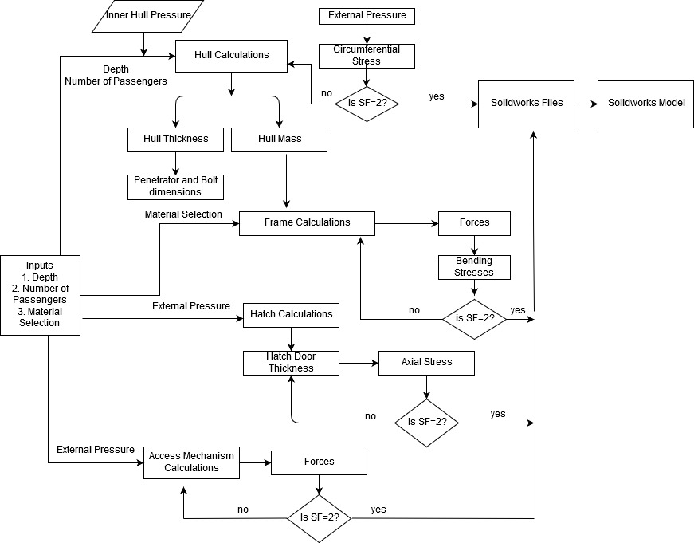
Main Design CodeFlow Chart
Depth: 330-1000m
Number of Passengers: 1-3
Material Selection: Type of metal for frame and fairings
Notes:
Here’s how it works:
We defined the constraints for each input parameter:
Our MATLAB code calculates dimensions based on a suitable safety factor. Once this safety factor is reached, the code generates new dimensions for the assembly and solidworks rebuilds the sub.

Slide 14
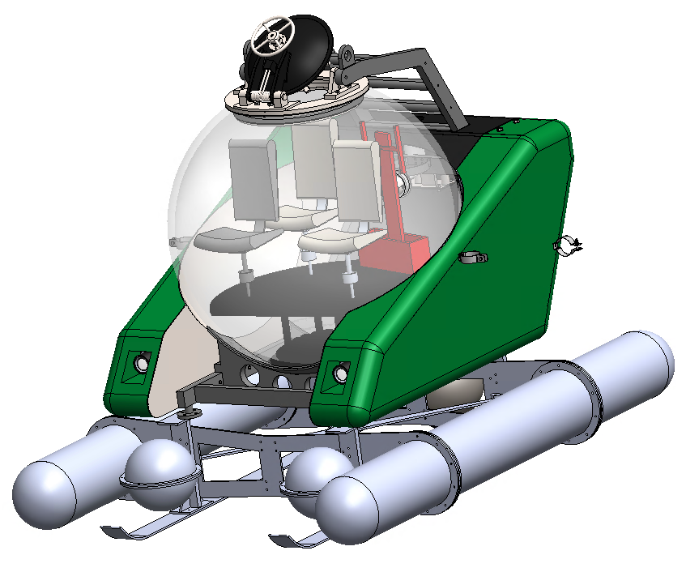
Extreme Cases(Depth)
330m, 3 occupants, SS
1000m, 3 occupants, SS

Slide 15
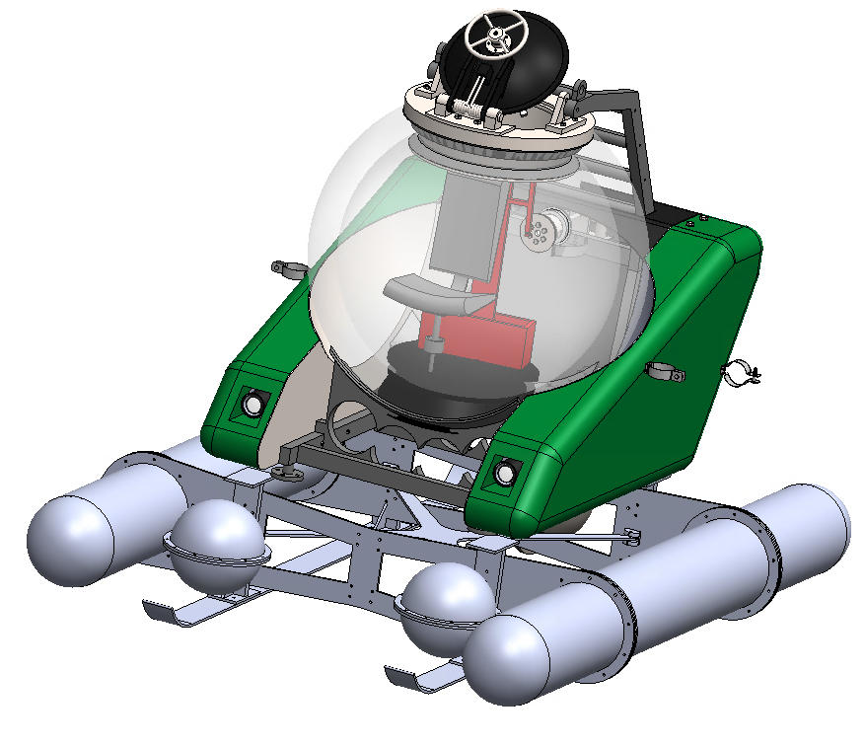
Extreme Cases (Occupants)
1000m, 1 occupants, SS
1000m, 3 occupants, SS

Slide 16
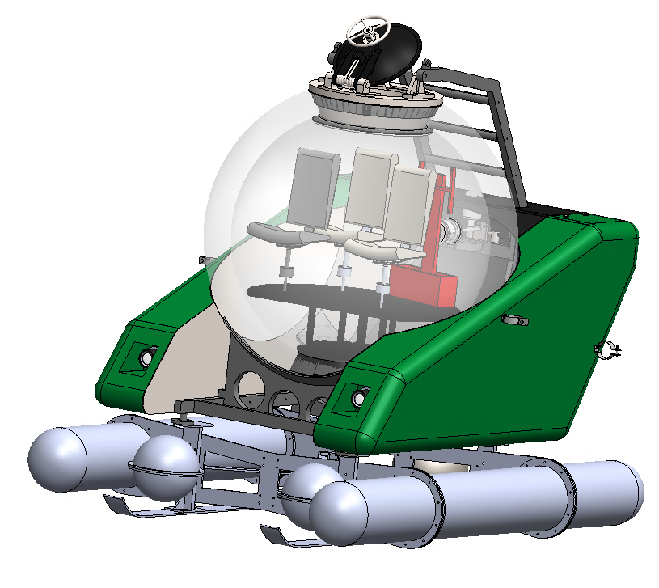
Extreme Cases (Metal Material)
1000m, 3 occupants, SS
1000m, 3 occupants, Ti

Slide 17
Thank You!
Questions?

